Slide 1
Introduction to Deep Learning Toolbox MATLAB
Mahir Jalanko
CHEMENG 4H03
Dr. Jake Nease

Slide 2
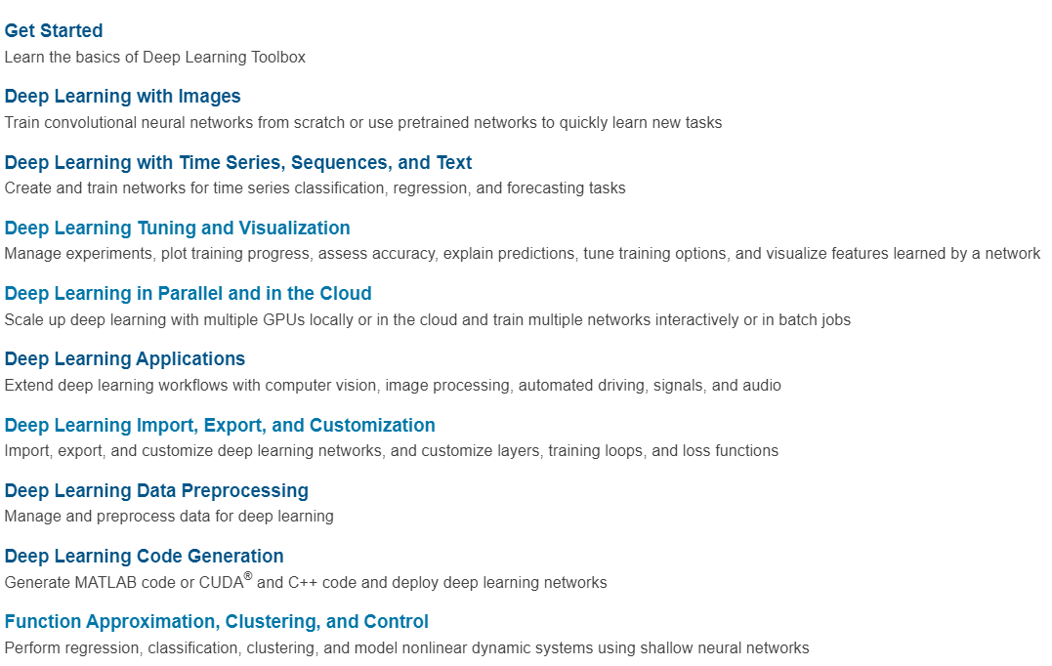
MATLAB Deep Learning Toolbox
Deep learning Toolbox provides a framework for designing and implementing deep neural network.
You can build Feedforward neural network (FNN), convolutional neural network (CNN), and other types of neural networks to preform classification and regression on image, time series, and text data.
Deep learning toolbox documentation cover the things shown in the image
https://www.mathworks.com/help/deeplearning/index.html?s_tid=CRUX_lftnav

Slide 3
Deep Learning Toolbox
Please go read the information in this link (you can skip the section that talks about Deep Learning Toolbox Application): https://www.mathworks.com/help/deeplearning/gs/shallow-networks-for-pattern-recognition-clustering-and-time-series.html
So now you should know that there are four different ways to use the Deep Learning Toolbox Software (listed on the website from the easiest to the hardest). Here in this course, we do not care which way you use.
I will start by introducing the first one (GUI) and give some direction to how you can accomplish what GUI does by using the code.
Using the code to develop your neural network will give you more freedom with choosing the network architecture, parameters of your training algorithm, and many other things.

Slide 4
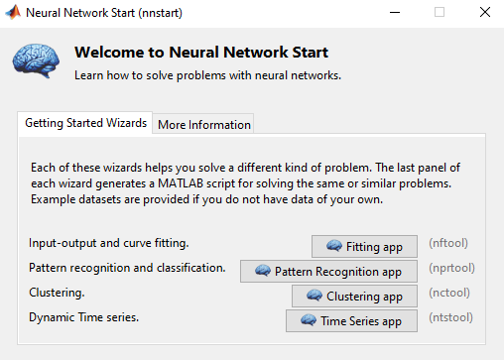
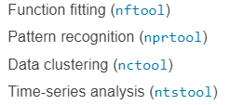
Easy way: GUI
You can go to the command window of your MATLAB and type: > nnstart
This will open the window you see on the right which are tools that you can use through GUI interference:
Once you select the tool you want, MATLAB will give you introduction about this specific tool.
We will select fitting app (nftool) here (most people will end up using this for their projects).

Slide 5
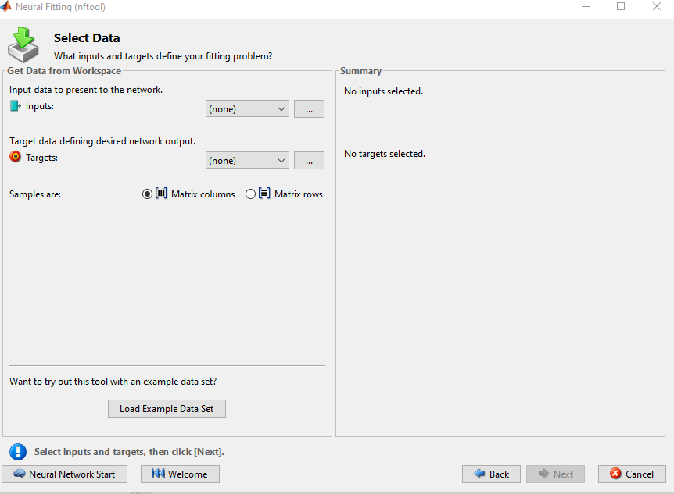
Easy way: GUI
You need to load your input and target data from excel and assign them to variable names. The variable names assigned to the data will show when clicking on (none).
Make sure you select if the different samples are organized in matrix columns or matrix rows (usually matrix rows).
You can load example dataset just to get familiar with the tool.

Slide 6
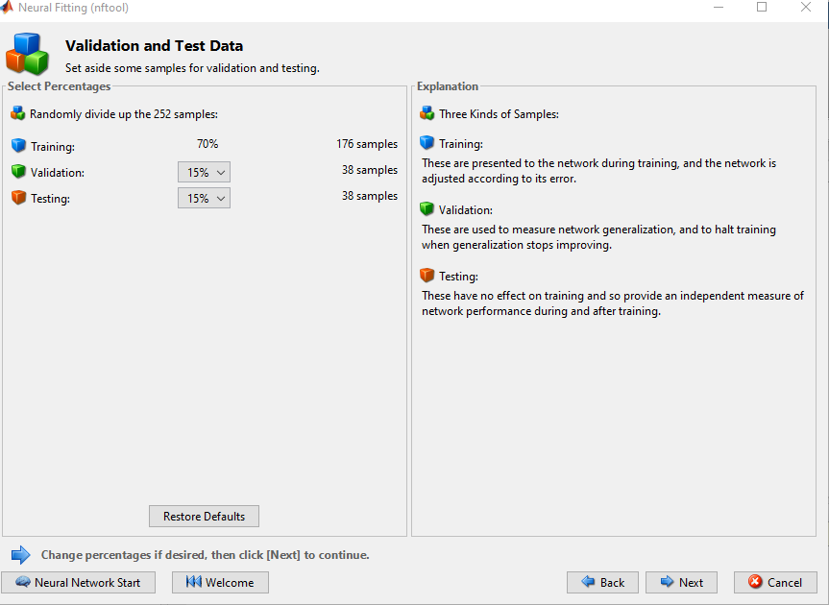
Easy way: GUI
Decide on how you want to split your data into training/validation/testing
The training data are used for training the ANN model by adjusting the parameters (Weights).
The validation data is used to measure network generalization and avoid overfitting by stopping the training when the network performance on the validation data starts declining.
The testing data does not get used during training and can be used to measure the network performance once training is over.

Slide 7
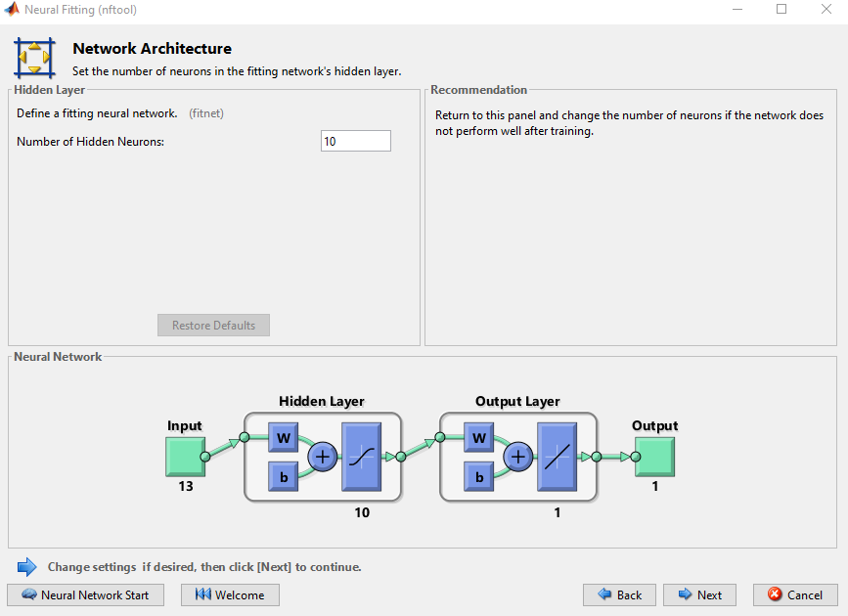
Easy way: GUI
Here select the number of neurons in the hidden layer.
Notice that you can not change the number of inputs and the number of neurons in the output layer. These are determined based on the number of variables in your input (X) and target (y).
Notice the line that says: Define a fitting neural network (fitnet) if you want to build your neural network by coding instead of using the GUI, you can click on fitnet and learn how you can build network with the code.
Building network with the code give you the freedom to change the number of hidden layers.

Slide 8
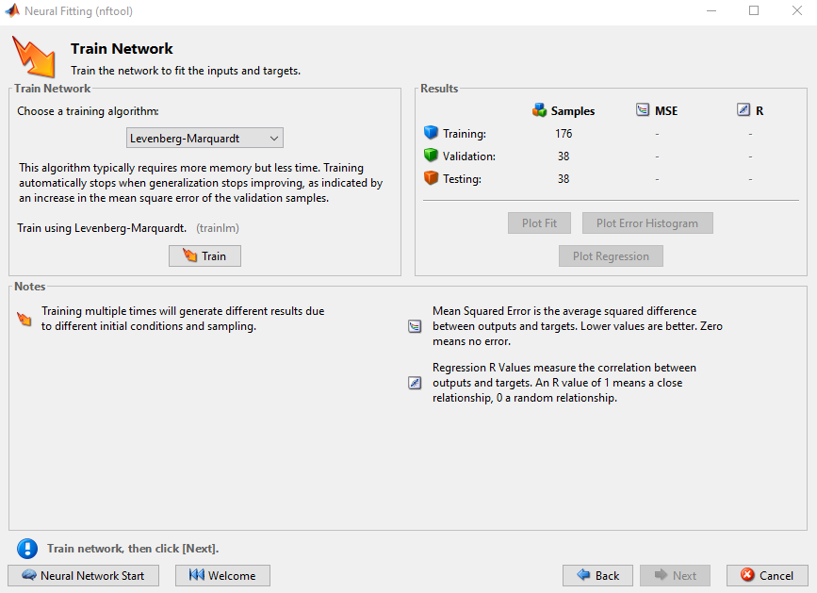
Easy way: GUI
Here select the training algorithm.
Once you select one of the training algorithms (trainlm, trainbr, or trainscg) you can read a bit about it and click on (trainlm), (trainbr), (trainscg) to read more about how to use the code to choose your training algorithm, the parameters associated with the training algorithm, and how to start training.
Example with the code (taken from the documentation):
% load the dataset (x:input, t:target)
> [x, t] = bodyfat_dataset;
% define your net to be a feedforwardnet with 10 neurons in % the hidden layer and trainlm as training algorithm
> net = feedforwardnet(10, 'trainlm’);
% train your model using input data x and target data t
> net = train(net, x, t);
% estimate the target y using input data x
> y = net(x);

Slide 9
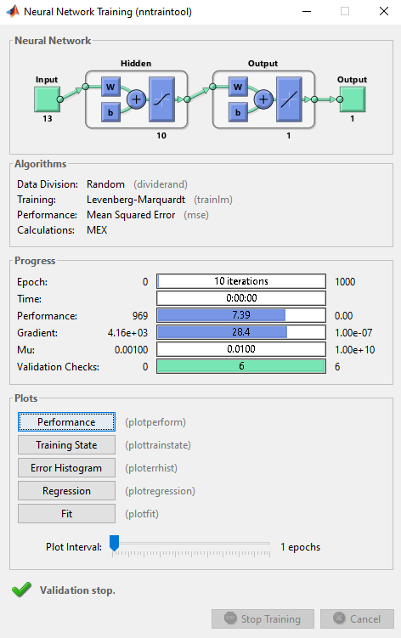
Easy way: GUI
The network training information will pop out once you hit on train (from previous slide):
Neural Network: This block shows you your neural network architectures with the activation function use (you can see we have sigmoid function in the hidden layer and linear activation function in the output layer).
Algorithm: This block will show you how the data were split into training, validation and testing (Random). It will show you the training algorithm (Levenberg-Marquardt) and the metric used to measure the model performance (Mean Squared Error).
Progress: This block will give you information about your training progress: number of epochs (10 iterations), time of training (0:00:00), performance of training dataset at the current number of epochs (7.39), and other information.
Plots: this block will let you analyze your network results (more details on this in next slide).
Notice that each the network information allows you to click on things like (dividerand, mse, plotperform,…etc) to learn how you can use these function with the code.

Slide 10
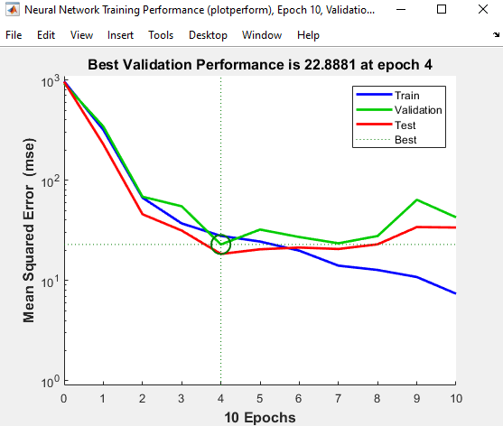
Easy way: GUI Performance Plot
Once we trained the model, it is time to generate some plots to evaluate our model.
If you select Performance from the Plots block, you will get the plot shown on the right.
The performance plot shows that the algorithm ran for 10 iteration but since there was no improvement in the performance on the validation data after epoch 4, it stopped the training and choose the parameters computed at epoch 10. MATLAB uses early stopping with a default number of epochs equal to 6. This means that if the performance on the validation data did not improve for 6 iterations, the algorithm will stop (the performance did not improve when going from epoch # 4 to epoch # 10).
Notice that the training performance is still improving after epoch 4, but the performance of validation and testing dataset is becoming worse which is a sign of overfitting on the training data.

Slide 11
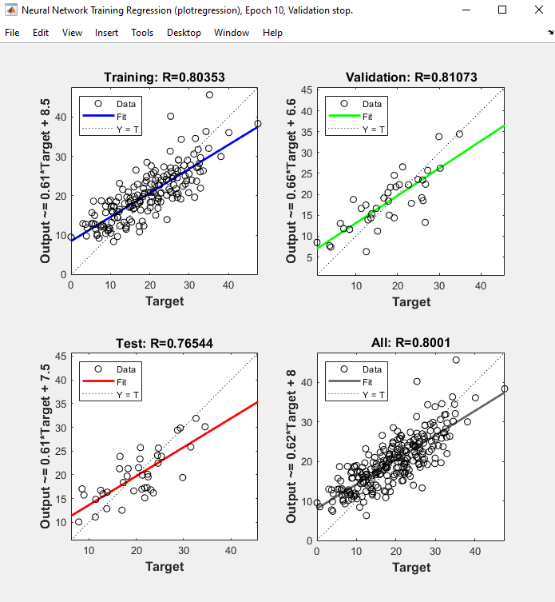
Easy way: GUI Regression Plot
If you select Regression from the Plots block, you will get the plot shown on the right.
These plots show the relationship between the outputs of the network and the targets for the training data, validation data, testing data, and all the data.
The results are perfect if Output = Target, and R values can be used to evaluate how good the model is performing (can be between -1 and 1, where 1 indicate there is an exact linear relationship between outputs and targets, 0 indicates no relationship).
Refer to this link for more discussion on analyzing neural network performance after training: https://www.mathworks.com/help/deeplearning/ug/analyze-neural-network-performance-after-training.html

Slide 12
References
Matlab Deep Learning Toolbox Documentation
https://www.mathworks.com/help/deeplearning/index.html?s_tid=CRUX_lftnav

